Slide 1
Using a Scorecard to Analyse Potential Partner Universities for INTO in US
By Rayan Malik
Notes:
Analysis of university data over the last 3 years was performed with particular emphasis on 2020
Filtered out unis by states already covered by INTO, then by good states, then with growth over the last 3 years
Created a scorecard based on 5 variables; Yearly Cost of Attendance, Yearly Earnings in 10 years, No of Total Students, Percentage of Foreign Students (Aliens), and Quality of State for Students. Weights were assigned to each variable and the Total Scores guided my choices
All California universities were at the top but decided to include two from Florida – Assuming diversity of states is ideal since INTO isn’t looking for partners in states it already has partners in
Assumptions: Goal of diversity and growth
Limitations: Didn’t assign weights to factors such as growth.

Slide 2
Executive Summary
Filtering and Defining Criteria
First Choice – University of California, LA
Second Choice – The University of Tampa
Third Choice – Kaiser University

Slide 3
Filtering by Fees and State and Defining Criteria to Create a Score Card
FILTERS
Middle 1/5th (40%-60%) of Yearly Cost of Attendance
States INTO doesn’t operate in
Top 7 States for Students
CRITERIA
Yearly Cost of Attendance
Yearly Earnings in 10 Years
Number of Total Students
%age of Foreign Students
Quality of State for Students

Slide 4
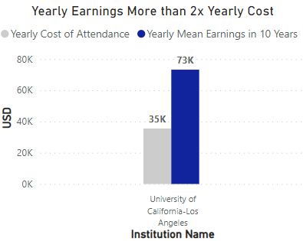
University of California – LA has a HUGE ROI (Yearly Earnings in 10Y/Yearly Cost of Attendance)
REASONS FOR CHOICE
Yearly Earnings in 10Y more than 2x Yearly Cost of Attendance
15.28% drop in Foreign Students Between 2018-2020
Student Body Larger than the US Average
BEST STATE FOR STUDENTS!
Notes:
Why these universities are good marketing partners - potential revenue and strong marketing points
Yearly Earnings vs Cost – Strong marketing point for price-sensitive customers
15.28% drop in foreign students, compared to 2.34% drop in total students. between 2018-2020 – Huge for California, popular among students
9.38% Foreign Students, compared to 14.9% State Average
No.1 Ranked State for Students

Slide 5
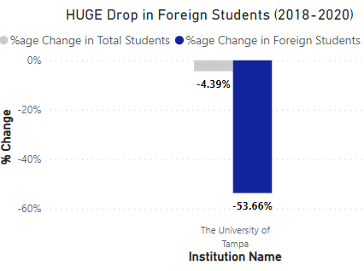
The University of Tampa – HUGE Drop in No. of Foreign Students
REASONS FOR CHOICE
53.66% Drop in No. of Foreign Students (2018-2020)
2.75% Foreign Students, compared to 7.8% Florida State Average
Yearly Earnings in 10Y 19.5% more than Yearly Cost of Attendance
5th Best State for Students

Slide 6
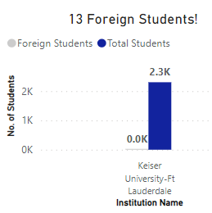
Kaiser University – Abnormally Low % of Foreign Students
REASONS FOR CHOICE
53.66% Drop in No. of Foreign Students (2018-2020)
0.56% Foreign Students, compared to 7.8% Florida State Average
5th Best State for Students
POINT OF CONCERN
Yearly Earnings in 10Y 14.6% lesser than Yearly Cost of Attendance

Slide 7
Thanks!
Do you have any questions?

Slide 8
Appendix 1: Score Card
Institution Name | University of California-Los Angeles | The University of Tampa | Keiser University-Ft Lauderdale
State | CA | FL | FL
Total Students(Score) | 6386(20) | 2069(8) | 2304(8)
Foreign/Total Students(Score) | 9.37%(16) | 2.75%(20) | 0.56%(20)
Total Cost of Attendance per Year(Score) | 35497(4) | 46341(2) | 40713(2)
Mean Earnings(Score | 73200(16) | 55100(10) | 35100(2)
State Rank(Score) | 1 | 5 | 5
Total Score | 61 | 43 | 35
Notes:
https://studee.com/discover/best-states-usa/
https://statisticsanddata.org/data/international-students-in-us-by-country-of-origin/#:~:text=Top%20Ten%20States%20by%20International%20Student%20Population&text=In%20first%20place%20is%20California,and%2014.9%25%20of%20the%20total.

Slide 9
Appendix 2: Dashboard
Dashboard:- https://app.powerbi.com/links/mBQnx5qnFy?ctid=15830474-cef0-4326-88db-96e5ab019d8a&pbi_source=linkShare
Notes:
https://studee.com/discover/best-states-usa/
https://statisticsanddata.org/data/international-students-in-us-by-country-of-origin/#:~:text=Top%20Ten%20States%20by%20International%20Student%20Population&text=In%20first%20place%20is%20California,and%2014.9%25%20of%20the%20total.

Slide 10
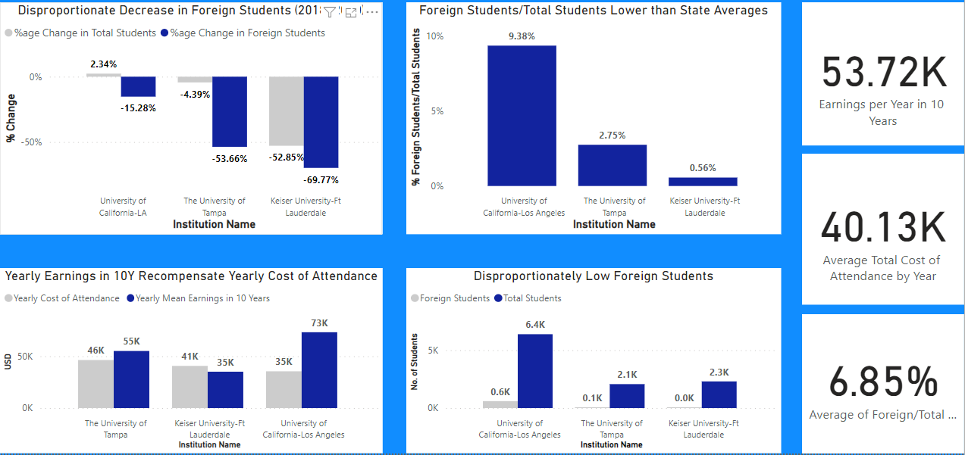
Exploring Opportunities For INTO Expansion in US

